Slide 1
Child & Family Studies Praxis Presentation
Jessie Zong

Slide 2
The Quad Manhattan

Slide 3
Twice Exceptional (2e)
Students who are intellectually or creatively gifted and also diagnosed with one or more learning disabilities
Their giftedness may often be overshadowed by their disabilities or vice versa

Slide 4
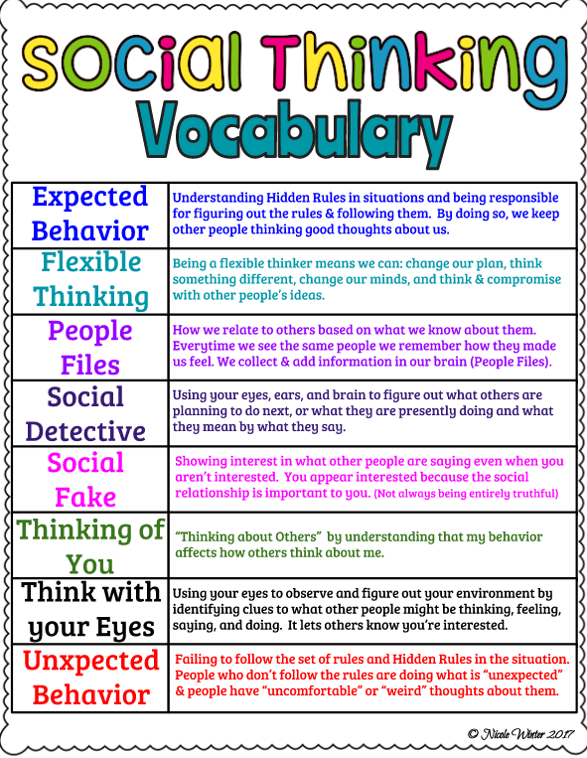
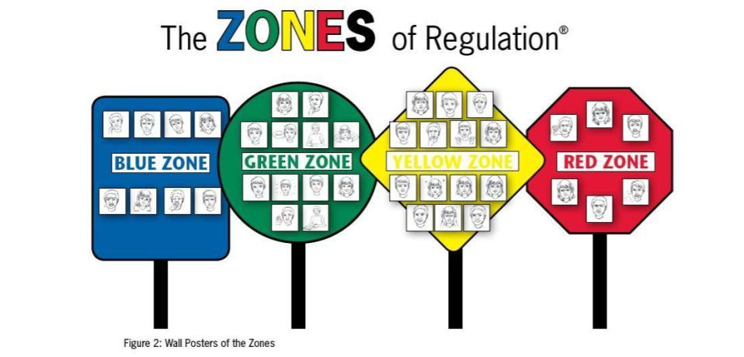
Integrated Classroom Strategies
The Zones of Regulation
Social Thinking Curriculum
Collaborative Problem Solving

Slide 5
The Quad Manhattan
Worked with kindergarten students (5-6 year olds)
Created individualized psychosocial plans for each student
Updated/tracked each child’s progress daily
Assisted classroom teachers throughout the day with camp activities as well as providing 1 on 1 support
Led mid-summer parent conferences
Completed of summer reports

Slide 6
Takeaways/Relevance to CFS
Interdisciplinary experience
Gaining more knowledge about 2e students and how to support them
Working directly with students, families, and psychologists

